Slide 1










NTI
MEDICAL ANALYSIS

Slide 2

DESCRIPE DATA
ORGANIZATION
PATIENTS
ENCOUNTERS
PAYERS
PROCEDURES

Slide 3
TARGET OF ANALYSIS
How many patients have been admitted or readmitted over time?
How long are patients staying in the hospital, on average?
How much is the average cost per visit?
How many procedures are covered by insurance?
Synthetic data on ~1k patients of Massachussets General Hospital from 2011-2022, including information on patient demographics, insurance coverage, and medical encounters & procedures.

Slide 4
Exploring DATA (PYTHON)
Data cleaning and processing:
Data organization
DUPLICATED
NULL
Clear label
DATE
numbers and percentages match
Analyst
Average Cost Analysis
Demographic Analyst
Analyzing health insurance

Slide 5
We extracted the columns we will need for the work
DATABASE
SQL
We made connections and keys
The data is ready after the link to access the useful information in the data.

Slide 6
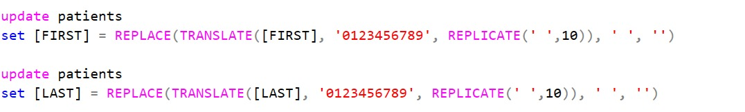

Slide 7
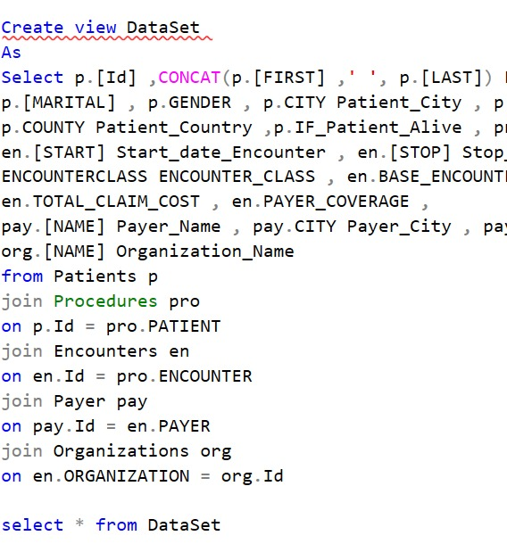

Slide 8
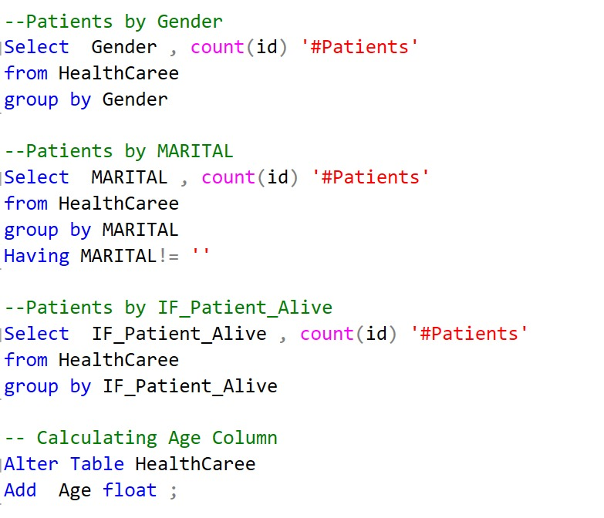

Slide 9
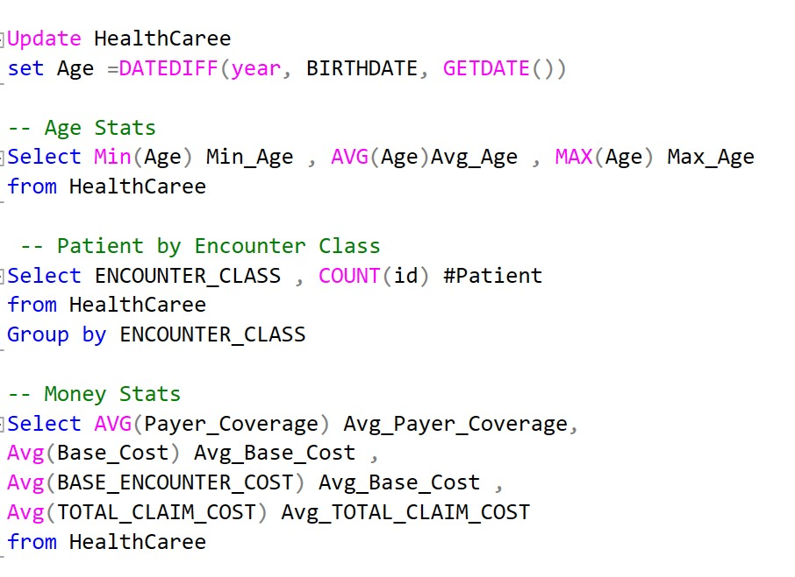

Slide 10
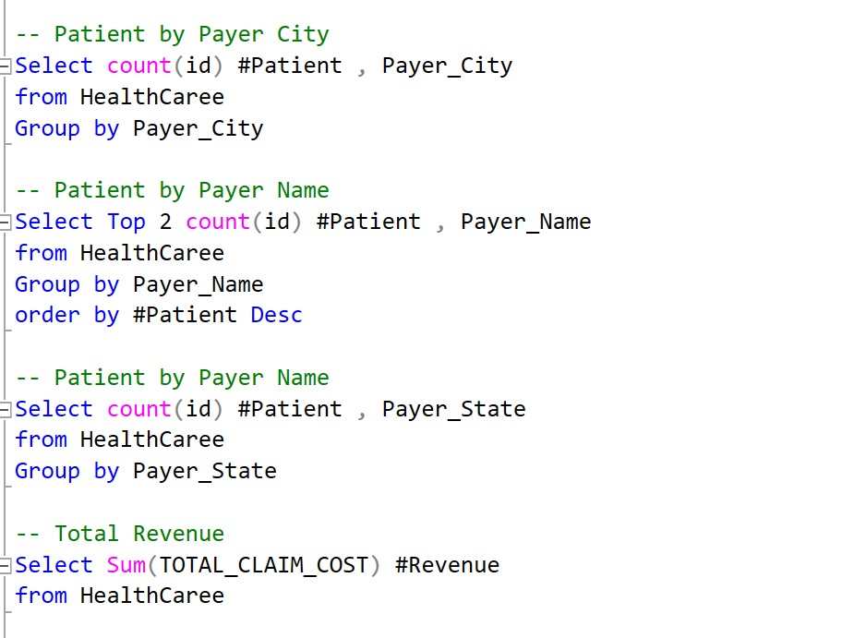

Slide 11
POWER BI

Slide 12
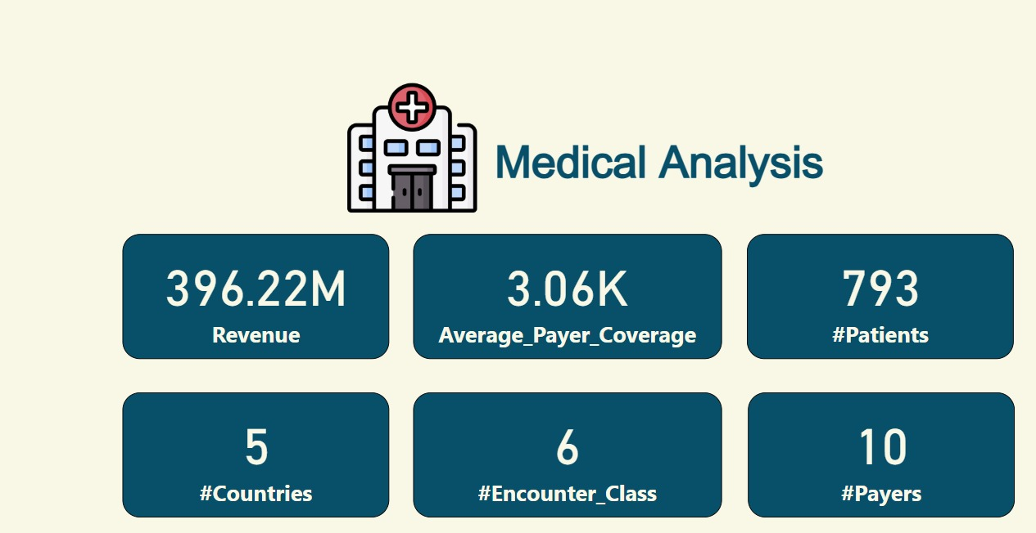

Slide 13
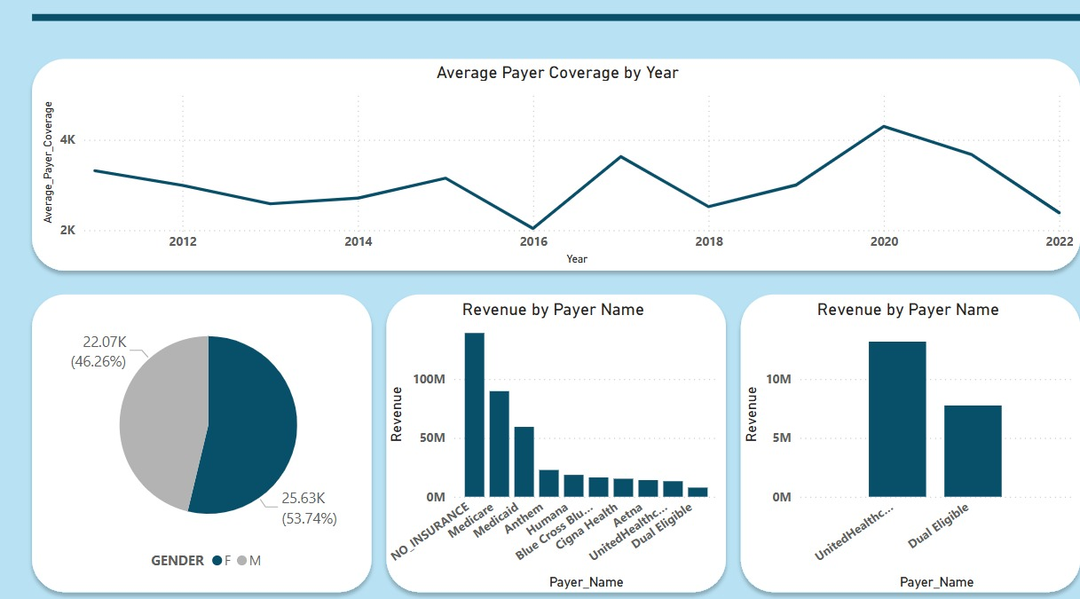

Slide 14
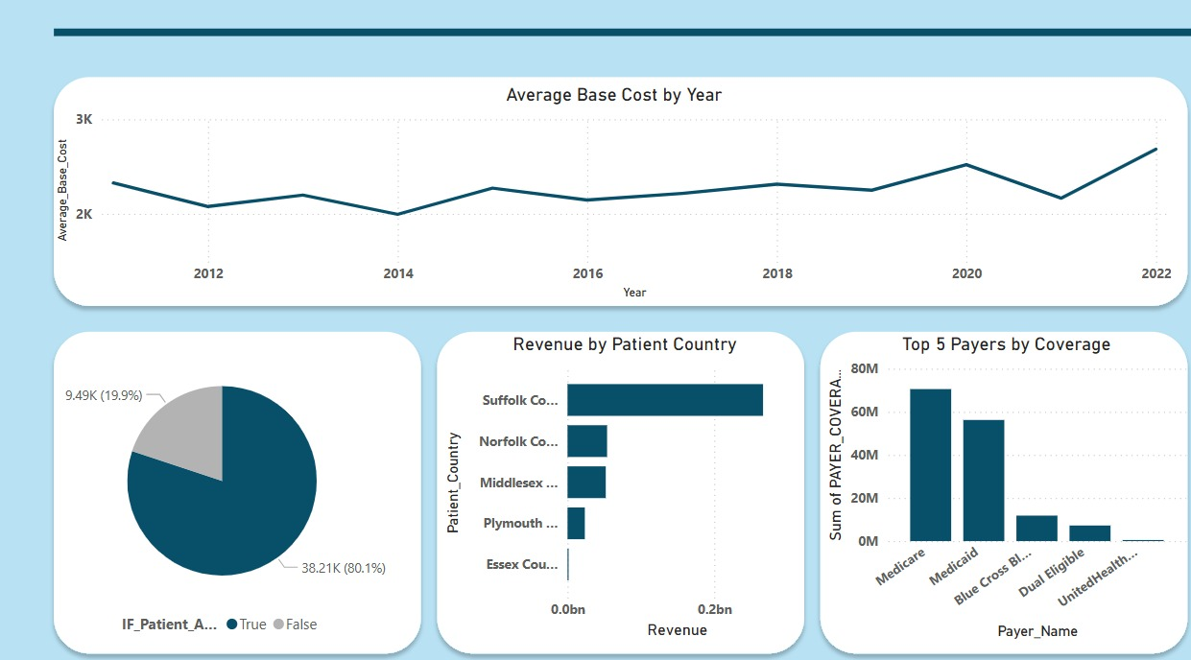

Slide 15
MAKE PIVOT TABLES
MAKE POWER QUERY
DATA WITH EXCEL
MAKE DASHBOARD

Slide 16
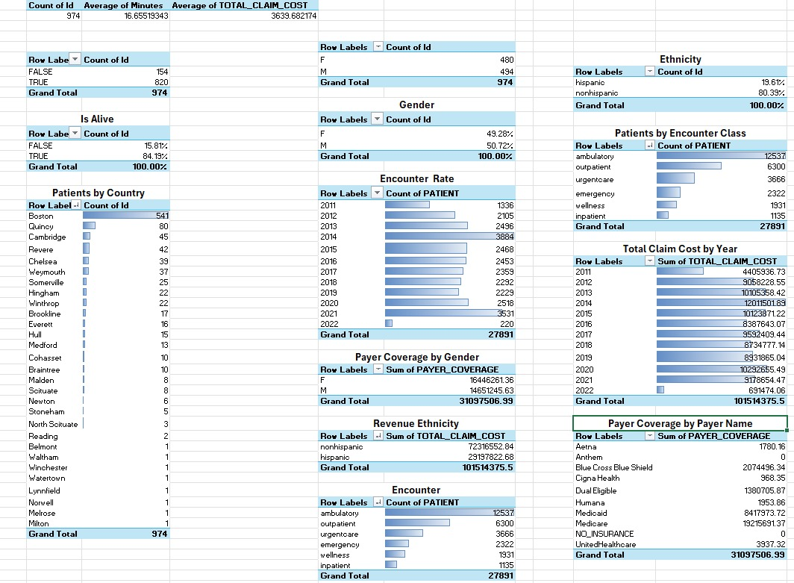

Slide 17
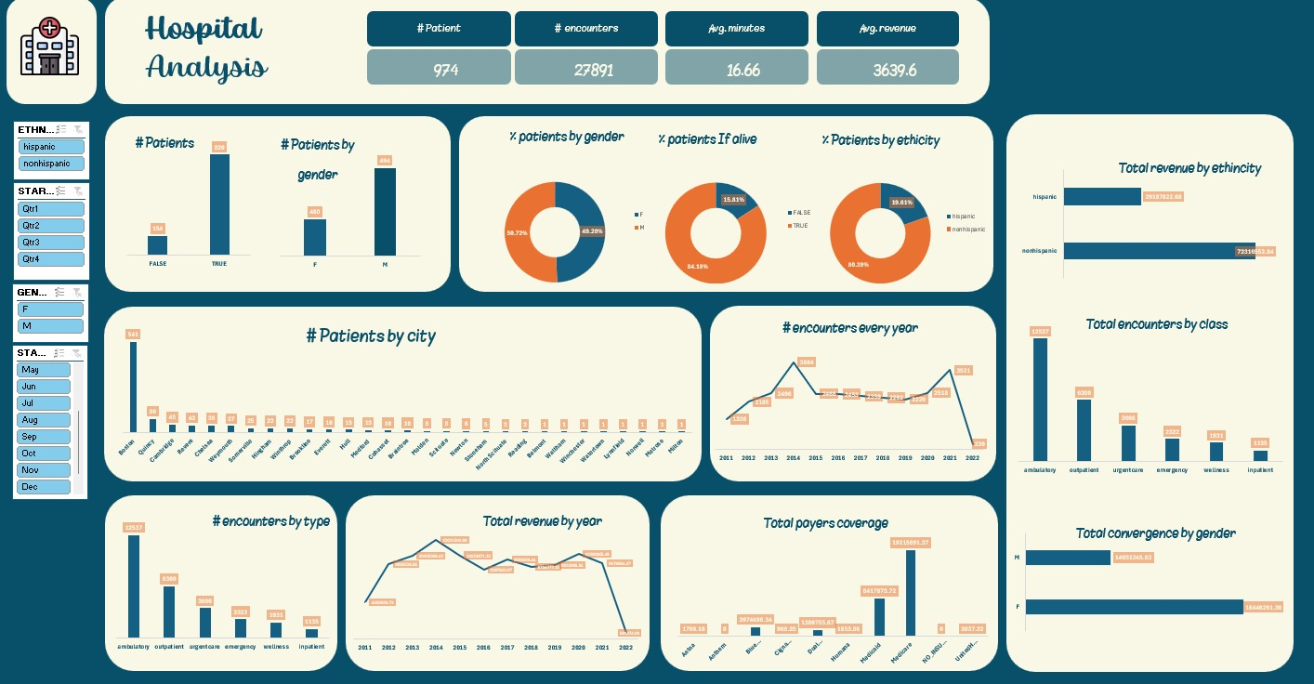

Slide 18
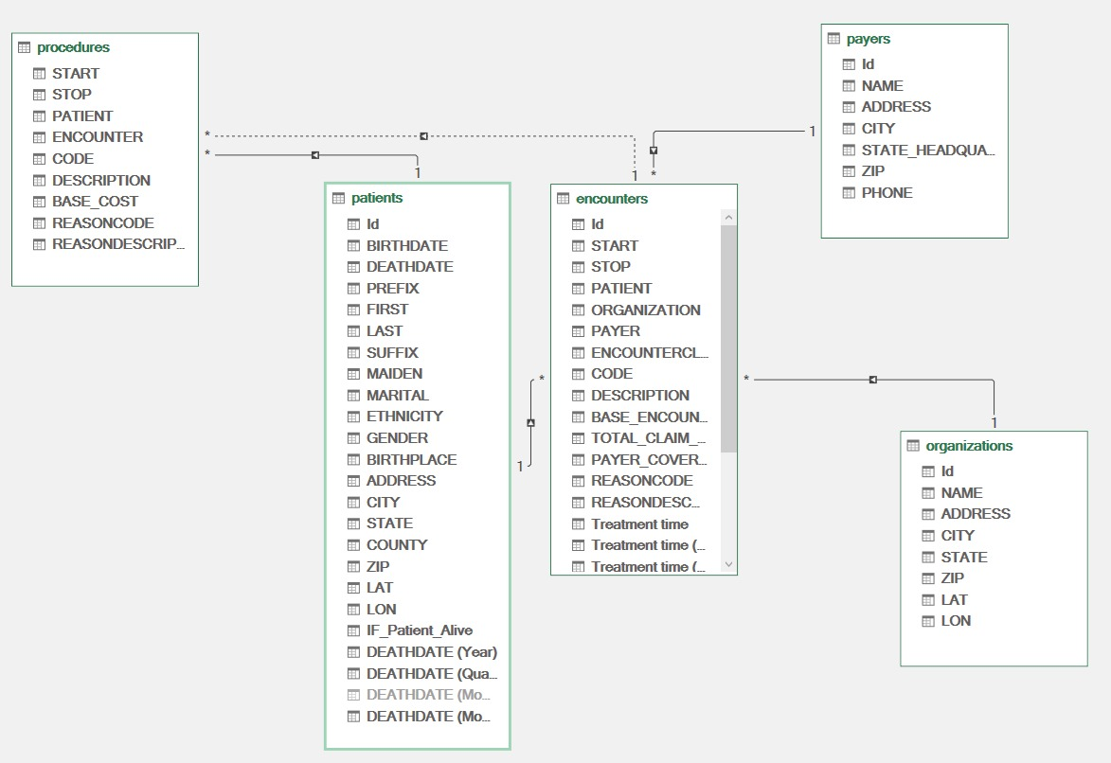

Slide 19
Thank you for your attention

